Slide 1

Chapter 6:
Graphics Processors

Slide 2

Background Required to Understand this Chapter
In-Order Pipelines
C++ Programming
Basic Parallel Programming
Chapter 2
The presentations uses various images licensed under the CC-SA licenses

Slide 3

Contents
1.
GPUs, ASICs, FPGAs
2.
Programming GPGPUs
3.
Design of GPGPUs

Slide 4

Numerical and Scientific Programs
Are we satisfied with an IPC of 4 or 6?
Many programs such as airplane wing simulation, weather prediction, image recognition have far more ILP and far higher performance requirements.
Linear algebra forms a core of these methods.
Consider the algorithm to add two matrices: for (i=0; i < N; i++) { for (j=0; j < N; j++) { C[i][j] = A[i][j] + B[i][j]; } }
O(N²) additions can happen in parallel

Slide 5

High-ILP Programs
Many linear algebra-based programs have a high ILP
Existing multicore processors are constrained in terms of their fetch and issue width
Solution: create a new processor that has 100s of ALUs for computing such instructions in parallel
Method:
Have a very simple ISA
Limit irregular memory accesses, conditional branches, and
Create a new processing framework for such parallel programs

Slide 6
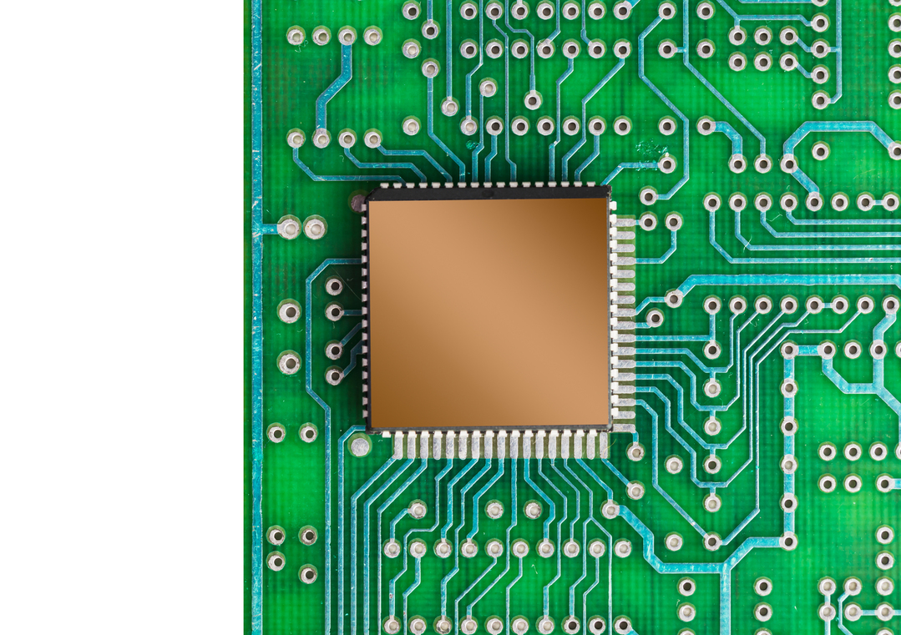
ASICs, ASIPs, and FPGAs
Create a custom chip with 100s of ALUs
ASIC – Application-specific integrated circuit
Used in all kinds of devices such as video cameras, washing machines, etc.
They can be made more programmable
ASIC → ASIP
Application-specific instruction set processor
Provides some degree of limited flexibility

Slide 7
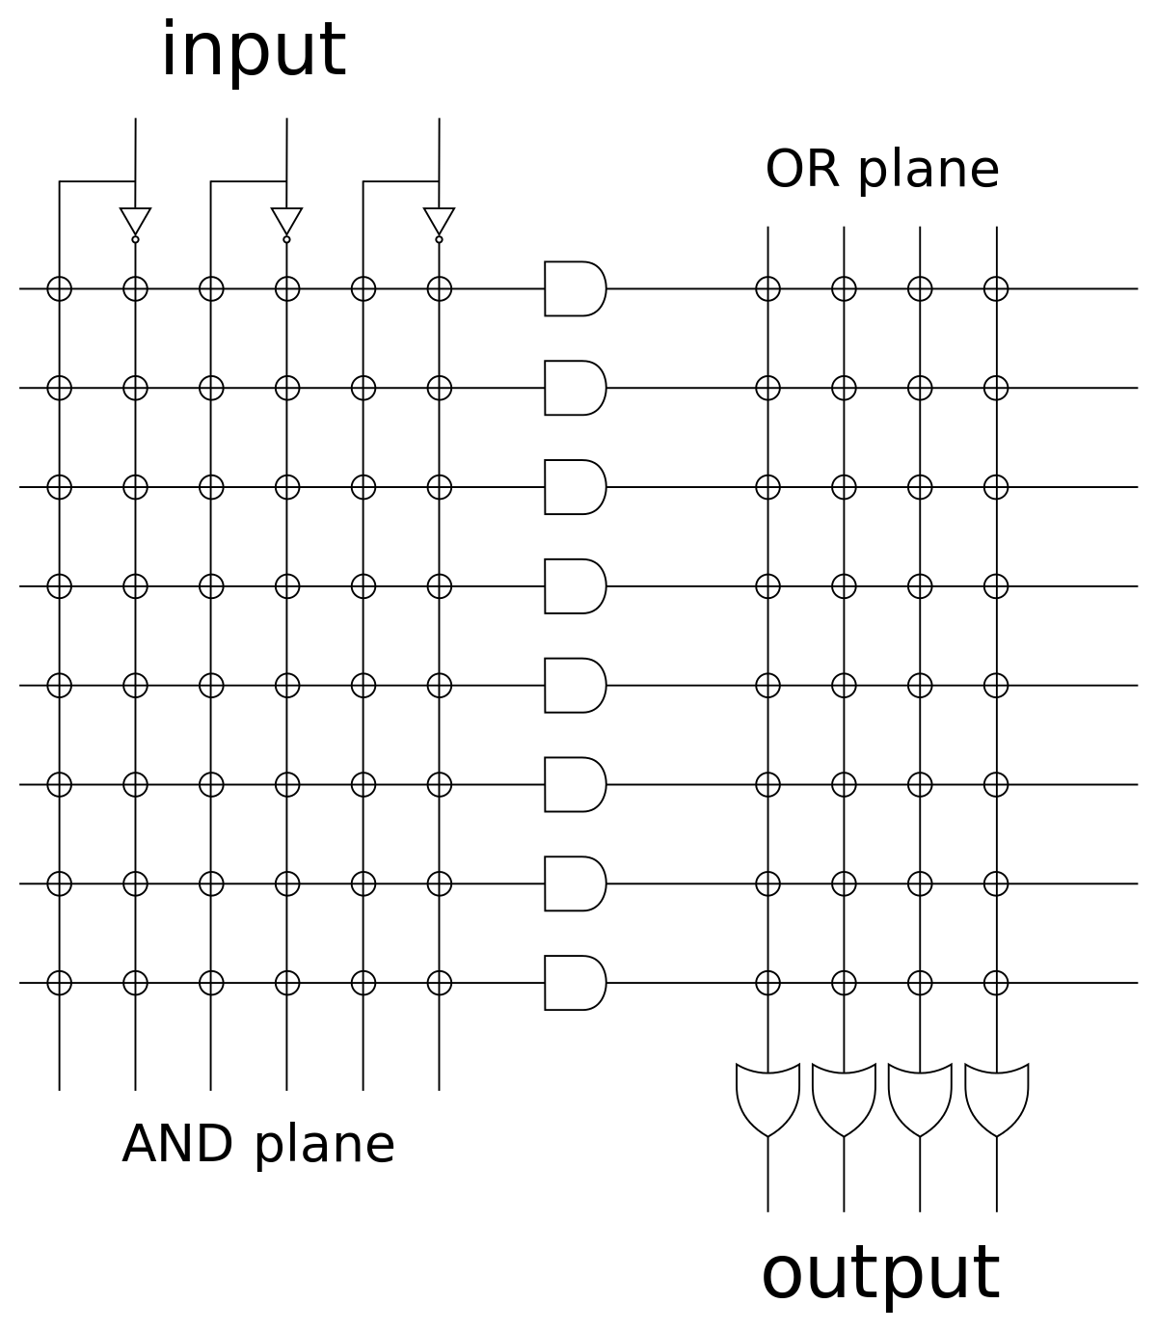
PLAs
In the good old days, we had PLAs (programmable logic arrays)
Used to implement any Boolean function
The AND plane computes the minterms
Used to implement any Boolean function (OR plane)

Slide 8
FPGAs
A PLA is used only for combinational logic functions
They cannot be used to implement a simple processor
We need state elements
A flexible interconnect
Use an FPGA
Uses a large number of LUTs (lookup tables) that are used to implement custom logic
A flexible interconnect that can be used to connect LUTs and state elements
Provide high computational throughput
Reconfigurable architectures have overheads
Maximum clock speed: 400 to 600 MHz

Slide 9


Traditional GPUs
They were traditionally used to only handle graphics-intensive tasks. These are numerical programs with high ILP.
Later they were repurposed to implement general numerical and scientific programs.

Slide 10
Need for GPUs
Example:
Consider a 1920 x 1080 HD display
Refresh rate: 60 frames/second
Roughly 125 million pixels have to be processed per second
A 3 GHz processor with an IPC of 2 (medium to high ILP) can process 6 billion instructions per second.
48 instructions per pixel.
Not enough for most high-intensity games
Graphics effects
HD movies

Slide 11
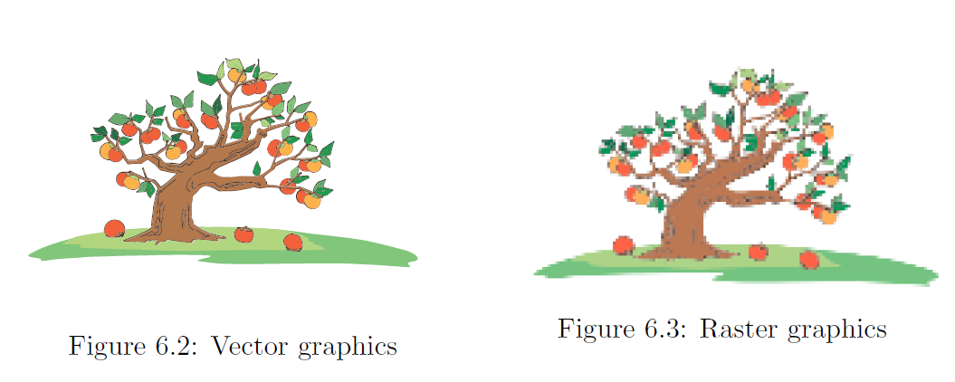
Need for GPUs – II
Vector Graphics
Raster Graphics
Earlier systems were simply showing images on the screen.
The image was represented as an array of pixels.
Very simple rules were used to create it.
It was simply shown on the screen.
This was raster graphics.

Slide 12
Need for GPUs – II
Vector Graphics
Raster Graphics
In modern systems, images are created from basic rules
The programmer creates high level objects: shades, textures, characters, worlds, etc.
She specifies the rules of interaction
The system generates the images: vector graphics
If we zoom the image, clarity is not lost

Slide 13
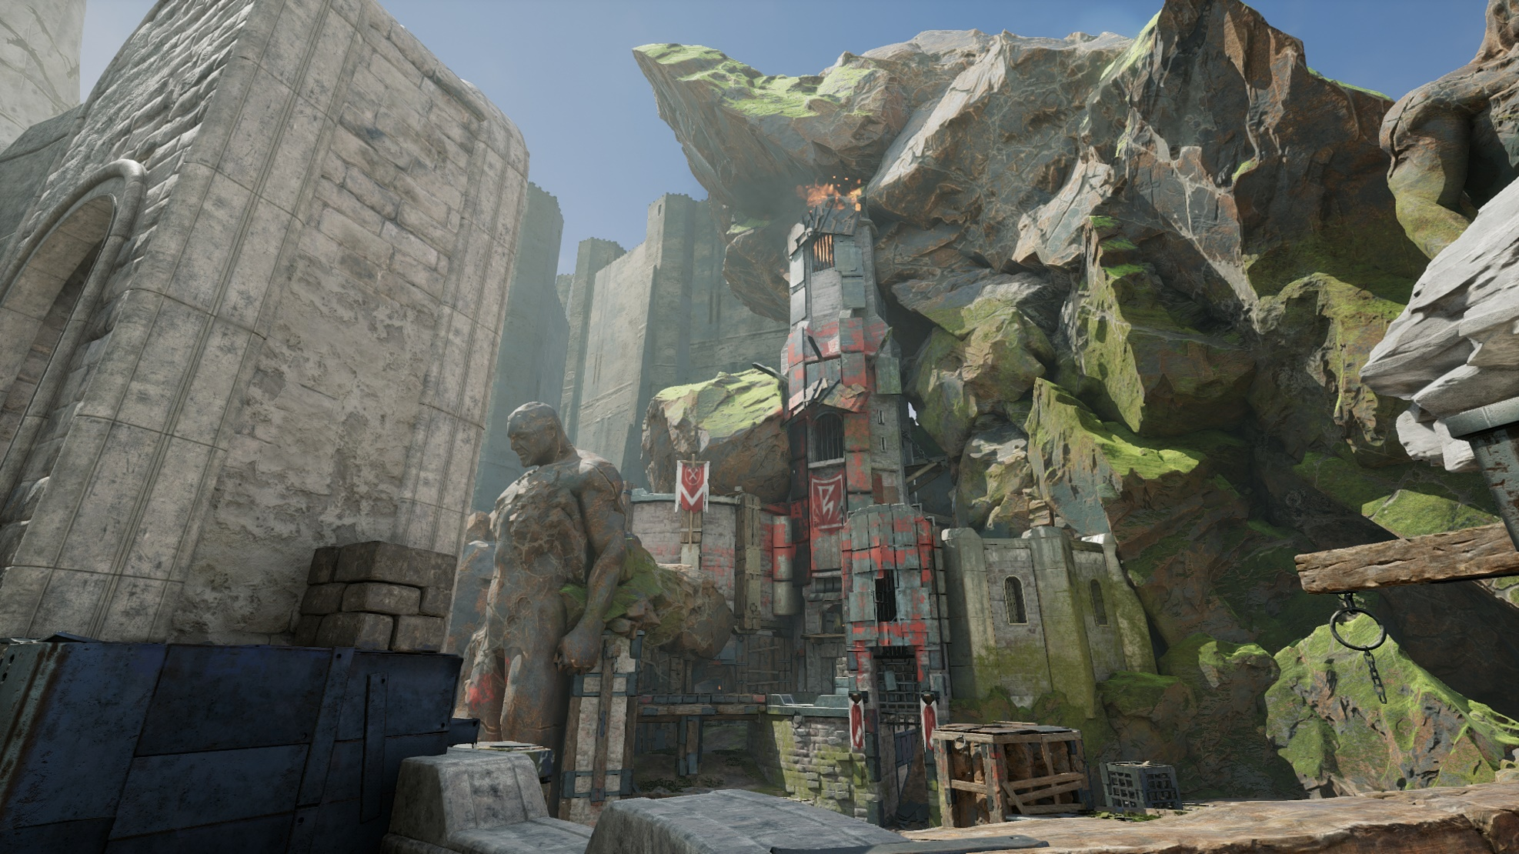
Example of an Auto-Generated Scene

Slide 14
Processing Requirements
The processing requirements for games, high-intensity graphics, movies, etc., is huge
Aggressive OOO processors (even multicore ones) are insufficient.
We need shader programs.
Custom language to work on objects, vertices, and pixels
Apply transformations to images: rotation, skewing, etc.
Apply effects: textures, shading, and illumination

Slide 15
Illustration of Shader Programs

Slide 16
Graphics Pipeline
Shader programs need a dedicated graphics pipeline.
The programmer specifies a scene in terms of the objects and an interaction between the objects
Dedicated programming language APIs: DirectX and OpenGL
GPU programs are written in two parts
There is a part that runs on a normal CPU
A part runs on the GPU (compiled in a GPU-specific ISA)

Slide 17


Program binary: CPU code and GPU code
Program binary
CPU code
NVIDIA programs are compiled to a virtual ISA → PTX (Portable Thread eXecution)
GPU code
At runtime, PTX is compiled to SASS. (Shader Assembly)

Slide 18

Vertex Processor
Decompose a 3D surface into a set of triangles.
Triangles have inherent advantages – all the vertices are on the same plane. Very easy to write code to process them.
Perform ray tracing – trace the path of light rays and model their interaction with surfaces
Add color and texture to a surface
Move, rotate, and scale objects – basic operations on triangles
Calculate the depth of the triangle (depth of the object in the image, measured from the eye)

Slide 19

Polymorph Engine
This has replaced the vertex processor in modern GPUs
Vertex fetch
Convert local object coordinates to world coordinates – same axes for all objects in a 3D coordinate system.
Vertex shader → Simulate the motion of limbs in lifelike characters, illumination, visual effects
Hull shader → Divide large polygons into smaller polygons. Objects closer to the viewpoint need to have a higher granularity.

Slide 20


Tessellation
Break down the polygons into a set of smaller objects – triangles and line segments.
Viewport Transformation
The total scene is the window.
The portion that is shown on the screen is the viewport.
This stage clips the scene and creates the viewport.

Slide 21


Attribute Setup
Compute the depth of each object.
Annotate its front face.
Perform ray tracing (if required).
Stream Output
Write the list of triangles to memory.

Slide 22

Rasterization
Set of triangles
Set of fragments
Each fragment is a set of pixels.
Compute the color and visibility of each fragment (optional)
There is a dedicated unit to perform rasterization.

Slide 23


Fragment Processor
Find the color of each fragment.
Color 1
Color 3
Color 2
Fragment
Interpolation
Texture mapping
Fog computation

Slide 24
Interpolation
Goraud shading
Assumes that the triangle is a flat surface
Takes into account the ambient light and the reflectivity of the surface
Linear interpolation: compute color values based on the colors of the vertices
Phong shading
Smoothly varying surface (need not be a plane)
Complex model for reflectivity
More time consuming

Slide 25
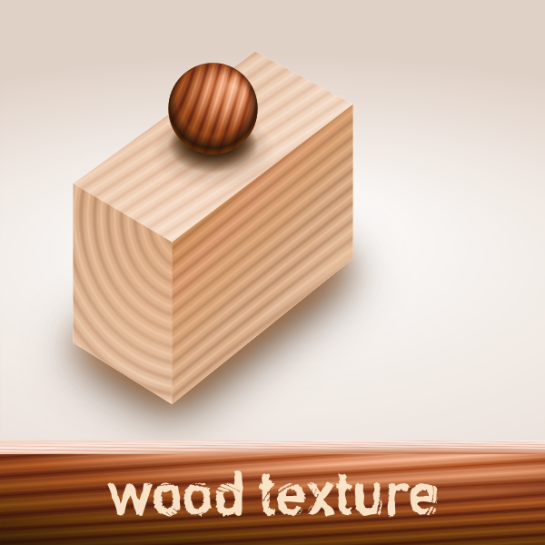
Textures
Apply a texture to each fragment.
Most GPUs have a dedicated cache to store texture information.

Slide 26

Fog Computation
Distance fog
3D rendering technique that colors pixels further away in the viewport differently
Provides the perception of distance
The information from the vertex processor can be reused here.

Slide 27

Pixel Engine
Depth and color buffering
Different fragments have different depths (Z-depth)
Transparency effects
32-bit color is represented as RGB and alpha
Based on the Z-depth, compute the visibility of the pixels
RGB → Red, Green, Blue
Alpha → Degree of transparency
Display translucent objects correctly.

Slide 28

Other Uses of GPUs
By early 2004
High-end processors had a peak throughput of 20 GFLOPS
GPUs were exceeding 50 GFLOPS. Reached 170 GFLOPS in a year.
Repurpose the GPU’s resources
Take linear algebra calculations → Map them to scenes
Let the GPU process the scenes
From the computed scene extract the results of the calculations.
Just design more flexible GPUs.
They can perform graphics-oriented tasks.
Can be used to perform general purpose tasks as well.

Slide 29
Contents
1.
GPUs, ASICs, FPGAs
2.
Programming GPGPUs
3.
Design of GPGPUs

Slide 30
NVIDIA’s CUDA Toolkit
CUDA → Compute Unified Device Architecture
Extension of C++
Allows the user to write code for GPUs
The GPU component is compiled into PTX
PTX is a RISC-like instruction set
Uses an infinite number of registers
Is compiled to SASS at runtime
The CUDA command nvcc compiles
The CPU code and the GPU code
Produces a fat binary – contains both CPU and GPU code

Slide 31
CUDA program compilation

Slide 32
GPU Kernels
GPU Kernel
It is a basic function that is executed on the GPU.
If there are N GPU threads, N versions of the kernel are run.
Example code to add two arrays.
Needs to run on the GPU
__global__ void vecAdd ( float *A, float *B, float *C) {
int idx = threadIdx .x;
C[idx] = A[idx] + B[idx ];
}

Slide 33
Arrangement of Threads: Thread Blocks
1D arrangement
2D arrangement
3D arrangement

Slide 34
Thread Blocks can be Arranged as a Grid
1D, 2D, and 3D organizations
Threads have two types of coordinates
Thread within the block, and block within the grid

Slide 35
Coordinates of a Thread
Every thread has an x, y, and z coordinate.
In a 1D organization, only the x coordinate is important. The rest of the coordinates default to 0
Likewise is the case for a 2D organization: only the x and y coordinates matter
A thread can fetch its index from threadIdx.x (1D arrangement)
Different threads have difference indices: 0 ... N-1
The addition happens in parallel
__global__ void vecAdd ( float *A, float *B, float *C) {
int idx = threadIdx .x;
C[idx] = A[idx] + B[idx ];
}

Slide 36
2D Thread Block
idx ← x coordinate
jdx ← y coordinate
__global__ void matAdd ( float A[N][N], float B[N][N], float C [N][N]){
int idx = threadIdx .x;
int jdx = threadIdx .y;
C[idx ][ jdx] = A[idx ][ jdx] + B[idx ][ jdx ];
}
int main (){
...
dim3 threadsPerBlock (N, N);
matAdd <<<1, threadsPerBlock >>>(A, B, C);
...
}
N x N matrix
1 block per grid

Slide 37
2D matrix of threads, and 2D matrix of blocks
__global__ void matAdd ( float A[N][N], float B[N][N], float C [N][N]){
int idx = blockIdx .x * blockDim .x + threadIdx .x;
int jdx = blockIdx .y * blockDim .y + threadIdx .y;
C[idx ][ jdx] = A[idx ][ jdx] + B[idx ][ jdx ];
}
int main () {
...
dim3 gridDimensions (N/16 , N /16) ;
dim3 threadsPerBlock (16 , 16);
matAdd <<< gridDimensions , threadsPerBlock >>> (A, B, C);
...
}

Slide 38
Synchronization
Threads within a block can synchronize with each other
They can call the __syncthreads() function
Acts as a barrier
Barrier: rendezvous/synchronization point
All the threads must reach it before any of the threads can proceed.
Blocks are meant to execute completely independently.

Slide 39
Memories in GPUs
GPUs have many types of memories.
Specifier | Meaning
__device__ | Resides in the GPU (device)
__constant__ | Resides in the GPU’s constant caches
__shared__ | Resides in shared memory (per block)
__managed__ | Shared between the CPU and GPU
General flow of computation
Transfer data from the CPU to GPU
Perform the computation on the GPU
Transfer the results back

Slide 40
Vector Addition (full code)
__global__ void vecAdd ( float *A, float *B, float *C) {
int idx = threadIdx .x;
C[idx ] = A[idx ] + B[idx ];
}
int main () {
...
/* Allocate the arrays A, B, and C on the CPU */
int size = N * sizeof ( float );
A = (int *) malloc ( size );
B = (int *) malloc ( size );
C = (int *) malloc ( size );
/* Initialise the arrays */
...
Allocate memory on the CPU

Slide 41
Vector Addition (full code) - II
/* Allocate A, B, and C on the GPU */
float *g_A = cudaMalloc (& g_A , size );
float *g_B = cudaMalloc (& g_B , size );
float *g_C = cudaMalloc (& g_C , size );
/* Copy vectors from the host to the device */
cudaMemcpy (g_A , A, cudaMemcpyHostToDevice );
cudaMemcpy (g_B , B, cudaMemcpyHostToDevice );
/* invoke the kernel */
vecAdd <<<1,N>>> (g_A , g_B , g_C);
/* Transfer from the device to the host */
cudaMemcpy (C, g_C , cudaMemcpyDeviceToHost );
/* Free the space on the GPU */
cudaFree (g_A );
cudaFree (g_B );
cudaFree (g_C );
}
Allocate memory on the GPU
Copy the inputs
Run the computation
Free memory

Slide 42

Streams
There are three phases in every computation.
Transfer to the GPU
Perform the computation
Transfer the results to the CPU
The transfer time represents a waste.
Solution: Create different streams of computation
Overlap them in time.
Think of a stream as a queue of “work items”
Operations in the same stream have a program order
Operations in different streams can be executed concurrently.

Slide 43

Streams – II
Illustration of parallelism with streams.

Slide 44
Example: Using Streams
cudaStream_t stream[2]; for (int i = 0; i < 2; ++i) cudaStreamCreate(&stream[i]);
float* hostPtr; cudaMallocHost(&hostPtr, 2 * size);
Creating streams
for (int i = 0; i < 2; ++i) {
cudaMemcpyAsync(inputDevPtr + i * size, hostPtr + i * size,
size, cudaMemcpyHostToDevice, stream[i]);
kernel_func <<<100, 512, 0, stream[i]>>>
(outputDevPtr + i * size, inputDevPtr + i * size, size);
cudaMemcpyAsync(hostPtr + i * size, outputDevPtr + i * size,
size, cudaMemcpyDeviceToHost, stream[i]);
}
Using
streams
Source: https://docs.nvidia.com/cuda/cuda-c-programming-guide/index.html#heterogeneous-programming

Slide 45
CUDA Graphs
Cost of launching the kernel and performing the data transfers is high.
If there are a large number of kernels, grouping them into streams is not good enough
Alternative solution:
The programmer creates a graph by specifying the nature of the data transfer, the details of the kernels, and the dependences between them.
Validate the graph, precompute the schedule, insert code for prefetching the data, and allocate resources

Slide 46
Visualization of a Graph
An arrow from A → B, indicates that A executes first, and B executes later.

Slide 47
More about CUDA Graphs
Types of nodes
Kernel
CPU function
Waiting or recording an event
Signaling a semaphore
Another subgraph
cudaGraphCreate
cudaGraphAddKernelNode
cudaGraphAddDependencies
Possible to create a graph out of a stream. Stream capture functionality.

Slide 48

CUDA Events
CUDA programs need to be profiled for performance
Insert events in the code
Find the time between elapsed events
Use the cudaEventElapsedTime function
cudaEventCreate (&start);
cudaEventCreate (&stop);
cudaEventRecord (start, streamid);
... computation ...
cudaEventRecord (stop, streamid); cudaEventSynchronize(stop);
cudaEventElapsedTime (&eTime, start, stop);
Waits until all the work associated with event stop is completed.

Slide 49
Contents
1.
GPUs, ASICs, FPGAs
2.
Programming GPGPUs
3.
Design of GPGPUs

Slide 50
Structure of the NVIDIA Volta GPU
Graphics processing cluster
The GPU can be on the same die or can be on the same board (connected with the PCI Express 3.0 bus)
The GigaThread Engine schedules the computations
There is a shared L2 cache
The NVLink modules can be used to create multi-GPU systems

Slide 51
The GPC
The Raster Engine still continues to have a separate existence.
The Polymorph engine is folded into the TPC.
Each TPC (Texture Processing Cluster) has multiple SMs (streaming multiprocessors)
The SMs are mostly generic computation blocks.

Slide 52
Structure of an SM
An SM has generic processing blocks and memory structures

Slide 53
Types of Memories in an SM
Type of Memory | Functionality
Instruction cache | Similar to an i-cache
L1 cache | Store regular data
Texture cache | Stores texture information
Constant cache | Stores constants
Shared memory | A shared memory that all the threads in the SM can access. Typically the __shared__ identifier is used to store arrays in this region.

Slide 54
Structure of a PB (processing block)
Schedule 32 threads in one go. We will see later that we will mostly be able to run 16 at a time.
Specialized for matrix multiplication.
Transcendental functions.

Slide 55

Concept of a Warp
How many threads can we run in parallel on our GPU?
Answer:
6 GPCs * 7 TPCs * 2 SMs/TPC * 4 PBs/SM * 16 threads
= 5,376 threads
Can we afford to give each thread its PC?
Answer:
What do we do?
Answer:
Create groups of 32 threads (a warp). Give them the same PC. Make them execute in lockstep.

Slide 56
Concept of a Warp – II
In a warp, all the threads complete the execution of an instruction first.
Then they move to the next instruction.
Assume we have 32 threads in a warp, and 16 cores.
The first group of 16 threads executes
Then, the second group of 16 threads executes
If because of a long latency operation, one of the threads needs to wait, then the entire warp waits.

Slide 57

What about code with conditional branches?
if (x > 0) {
a = 1;
b = a + 3;
c = b * b;
} else {
d = 3;
c = d * d;
}
x = c;
Executed by Thread 1
Executed by Thread 2
Predicated execution
Assume two threads
Both the threads process all the instructions
Threads just ignore the instructions that are on the wrong path (for them)

Slide 58

Predicated Execution: Previous example

Slide 59
How is Predicated Execution Achieved?
Each thread maintains a stack
When we enter the body of an if or else statement, we push a 1 or 0 on to the stack depending on whether we are on the correct path or wrong path (respectively)
An instruction is executed if and only if:
The stack is empty
OR
All the entries in the stack are 1
When we leave the body of the if or else statement, we pop the stack

Slide 60
Predicated Execution: Example of a Stack

Slide 61
Example of a Deadlock
Stuck forever
x = 0;
if ( threadIdx .x < 2) {
while (x == 0) {}
} else {
x = 1;
y = 1;
}
It is possible to have a deadlock
Assume four threads: 0, 1, 2, and 3
Even if all but one of the threads will set x to 1, they will all be stuck forever in the while loop.

Slide 62
Per-Thread State
Symbol | Meaning
W | while loop
X | x = 1
Y | y = 1
Execute the while loop for some time
Go to the else part and execute it for some time.
Again, come back to the while loop
Restricted lockstepped execution; finally reconverge

Slide 63
The GPGPU Pipeline
A scoreboard tracks the dependences among instructions and does not allow instructions to go through if there are RAW, WAR, or WAW dependences
This is an in-order pipeline.

Slide 64
Register File Access
Simple yet impractical
We access 32 registers in one go
We need to read 32*32 = 1024 bits (128 bytes)
This requires a very high register read bandwidth

Slide 65
Solution
Simple solution: Each entry in a register file bank is 1024 bits (128 bytes) wide
This is often impractical → Distribute the bytes across the banks.
Have a large number of banks in the register file
Use a dedicated set of operand collectors to collect the values of all the registers from different banks.
Have a small on-chip network to route register values between the banks and the operand collector.

Slide 66
The L1 Cache
Elevated chance of bank conflicts – concurrent accesses to the same bank
Send all the mutually non-conflicting accesses to the banks first
Then send the rest of the accesses in subsequent cycles
For writes, we lock the individual caches lines as they come into the cache. We replay all the load/store accesses for the set of lines (that arrived in the shadow of the miss).

Slide 67
Conclusion
GPUs are required for accelerating graphics
based applications. CPUs have inadequate resources.
Early GPUs were too customized for specific applications.
GPGPUs arrived later for generic numerical codes.
The CUDA language was developed to run generic codes on GPUs. A CUDA binary has both CPU and GPU-specific code.
GPUs have a complex hierarchical structure: GPC → TPC → SM → PB → ALUs.
A warp requires 1024 bits in one go. This necessitates
a complex, multi-banked register file and L1 cache.

Slide 68
The End

